Slide 1
Cornerstone City Church Peninsula Plus Community Hoo Are Ya
17th December 2023

Slide 2


Slide 3


Slide 4


Slide 5
Hark The Herald Angels Sing
CCLI Song # 27738
Charles Wesley | Felix Mendelssohn-Bartholdy
© Words: Public Domain
Music: Public Domain
For use solely with the SongSelect® Terms of Use. All rights reserved. www.ccli.com
CCLI Licence No. 33265

Slide 6
1/6
Hark the herald angels sing
Glory to the new born King
Peace on earth and mercy mild
God and sinners reconciled

Slide 7
2/6
Joyful all ye nations rise
Join the triumph of the skies
With the angelic hosts proclaim
Christ is born in Bethlehem
Hark the herald angels sing
Glory to the new born King

Slide 8
3/6
Christ by highest heav'n adored
Christ the everlasting Lord
Late in time behold Him come
Offspring of the Virgin's womb

Slide 9
4/6
Veiled in flesh the Godhead see
Hail th'incarnate Deity
Pleased as man with men to dwell
Jesus our Emmanuel
Hark the herald angels sing
Glory to the newborn King

Slide 10
5/6
Hail the heav'n-born Prince of Peace
Hail the Sun of Righteousness
Light and life to all He brings
Ris'n with healing in His wings

Slide 11
6/6
Mild He lays His glory by
Born that man no more may die
Born to raise the sons of earth
Born to give them second birth
Hark the herald angels sing
Glory to the newborn King

Slide 12
O Come All Ye Faithful CCLI Song # 4758525
C. Frederick Oakeley | John Francis Wade | William Henry Monk
© Words: Public Domain
Music: Public Domain
For use solely with the SongSelect® Terms of Use. All rights reserved. www.ccli.com
CCLI Licence No. 33265

Slide 13
1/8
O come all ye faithful
Joyful and triumphant
O come ye O come ye to Bethlehem
Come and behold Him
Born the King of angels

Slide 14
2/8
O come let us adore Him
O come let us adore Him
O come let us adore Him
Christ the Lord

Slide 15
3/8
God of God
Light of light
Lo He abhors not the virgin's womb
Very God
Begotten not created

Slide 16
4/8
O come let us adore Him
O come let us adore Him
O come let us adore Him
Christ the Lord

Slide 17
5/8
Sing choirs of angels
Sing in exultation
Sing all ye citizens of heaven above
Glory to God
In the highest

Slide 18
6/8
O come let us adore Him
O come let us adore Him
O come let us adore Him
Christ the Lord

Slide 19
7/8
Yea Lord we greet Thee
Born this happy morning
Jesus to Thee be glory given
Word of the Father
Now in flesh appearing

Slide 20
8/8
O come let us adore Him
O come let us adore Him
O come let us adore Him
Christ the Lord

Slide 22
O Little Town of Bethlehem CCLI Song # 2312176
Henry Walford Davies | Phillips Brooks
Words: Public Domain; Music: Public Domain
For use solely with the SongSelect® Terms of Use. All rights reserved. www.ccli.com
CCLI License # 33265

Slide 23
1/4
O little town of Bethlehem
How still we see thee lie
Above thy deep and dreamless sleep
The silent stars go by
Yet in thy dark streets shineth
The everlasting Light
The hopes and fears of all the years
Are met in thee tonight

Slide 24
2/4
O morning stars together
Proclaim the holy birth
And praises sing to God the King
And peace to men on earth
For Christ is born of Mary
And gathered all above
While mortals sleep the angels keep
Their watch of wond'ring love

Slide 25
3/4
How silently how silently
The wondrous gift is giv'n
So God imparts to human hearts
The blessings of His heav'n
No ear may hear His coming
But in this world of sin
Where meek souls will receive Him still
The dear Christ enters in

Slide 26
4/4
O holy Child of Bethlehem
Descend to us we pray
Cast out our sin and enter in
Be born in us today
We hear the Christmas angels
The great glad tidings tell
O come to us abide with us
Our Lord Emmanuel

Slide 27
Silent Night CCLI Song # 4629513
Bart Millard | Brown Bannister | Franz Xaver Gruber | Jim Bryson | John Freeman Young | Joseph Mohr | Mike Scheuchzer | Nathan Cochran | Robby Schaffer
© 2005 Simpleville Music; Wet As A Fish Music; Banistuci Music
For use solely with the SongSelect® Terms of Use. All rights reserved. www.ccli.com
CCLI License # 33265

Slide 28
1/3
Silent night holy night
All is calm all is bright
Round yon virgin mother and Child
Holy Infant so tender and mild
Sleep in heavenly peace
Sleep in heavenly peace

Slide 29
2/3
Silent night holy night
Shepherds quake at the sight
Glories stream from heaven afar
Heav’nly hosts sing alleluia
Christ the Saviour is born
Christ the Saviour is born

Slide 30
3/3
Silent night holy night
Son of God love's pure light
Radiant beams from Thy holy face
With the dawn of redeeming grace
Jesus Lord at Thy birth
Jesus Lord at Thy birth

Slide 32
Christians Awake CCLI Song # 2745657
John Byrom
Public Domain
For use solely with the SongSelect® Terms of Use. All rights reserved. www.ccli.com
CCLI License # 33265

Slide 33
1/4
Christians awake salute the happy morn
Whereon the Saviour of mankind was born
Rise to adore the mystery of love
Which hosts of angels chanted from above
With them the joyful tidings first begun
Of God incarnate and the Virgin's Son

Slide 34
2/4
Then to the watchful shepherds it was told
Who heard the angelic herald's voice behold
I bring good tidings of a Saviour's birth
To you and all the nations upon earth
This day hath God fulfilled His promised word
This day is born a Saviour Christ the Lord

Slide 35
3/4
O may we keep and ponder in our mind
God's wondrous love in saving lost mankind
Trace we the Babe who hath retrieved our loss
From His poor manger to His bitter cross
Tread in His steps assisted by His grace
Till man's first heavenly state again takes place

Slide 36
4/4
Then may we hope the angelic hosts among
To sing redeemed a glad triumphant song
He that was born upon this joyful day
Around us all His glory shall display
Saved by His love incessant we shall sing
Eternal praise to heaven's almighty King

Slide 37


Slide 38
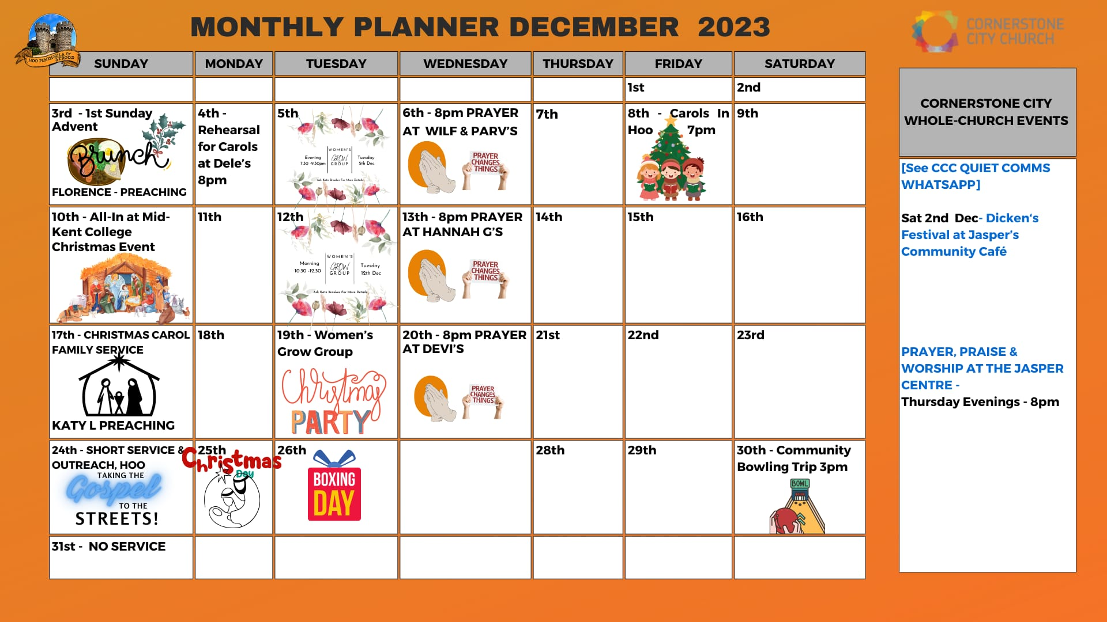

Slide 39
It is confirmed that our Community will have a new member next year June 2024

Slide 40
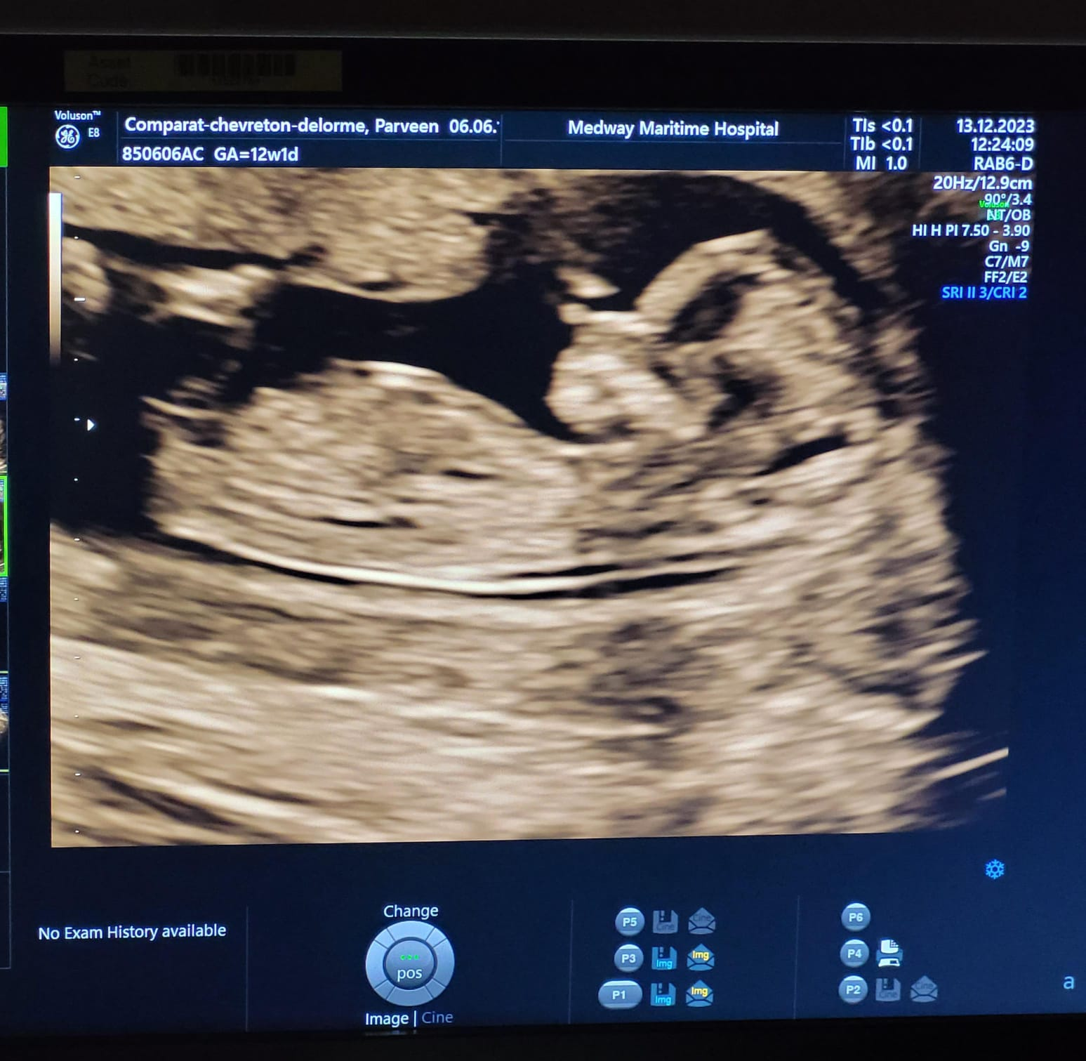

Slide 41


Slide 42


Slide 43
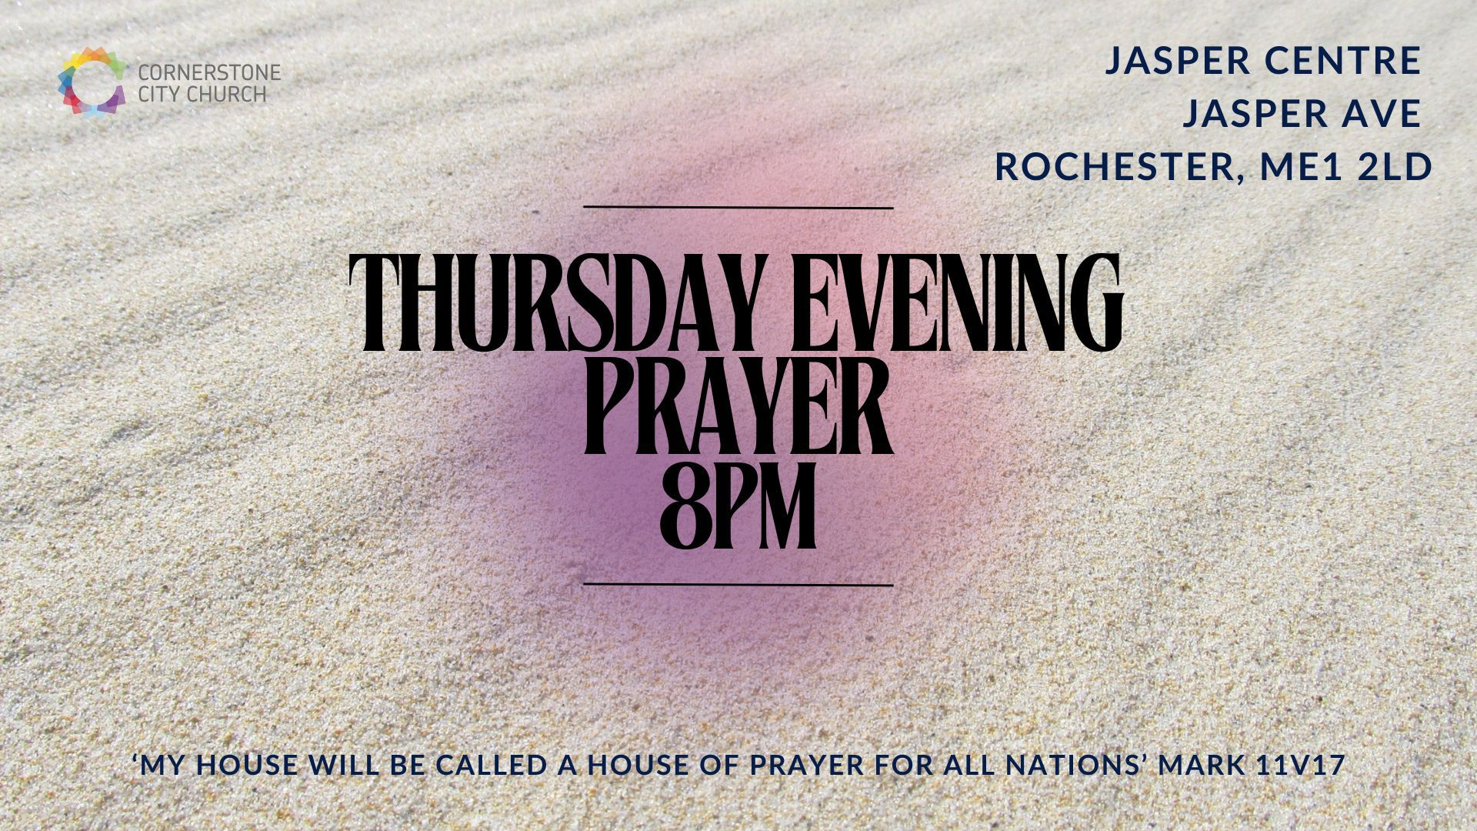

Slide 44


Slide 45


Slide 46


Slide 47
2 Corinthians 14 May the grace of the Lord Jesus Christ, and the love of God, and the fellowship of the Holy Spirit be with you all

